Slide 3
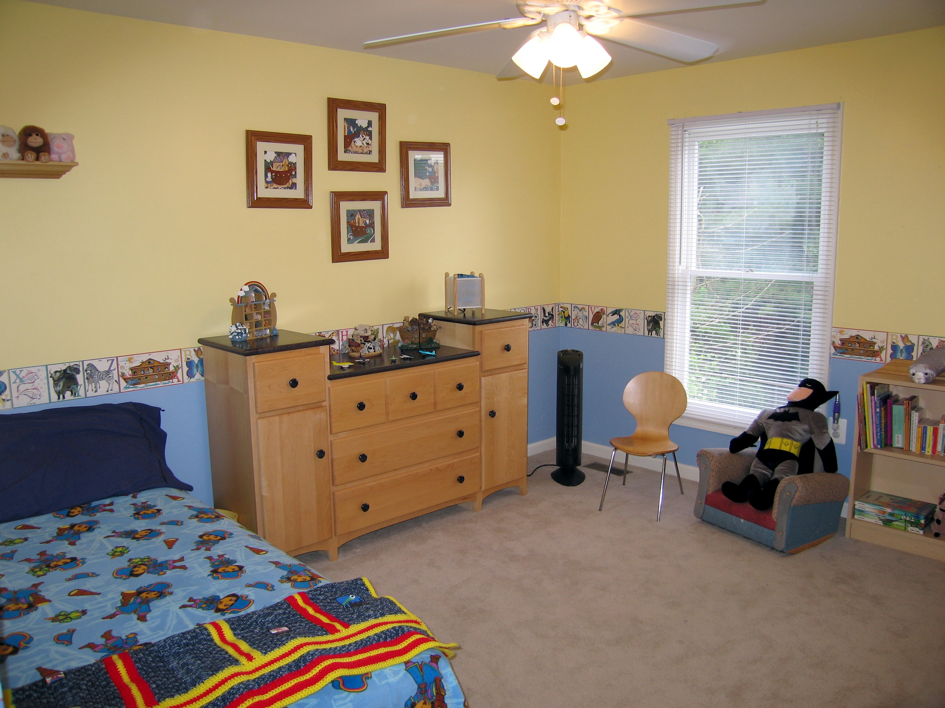
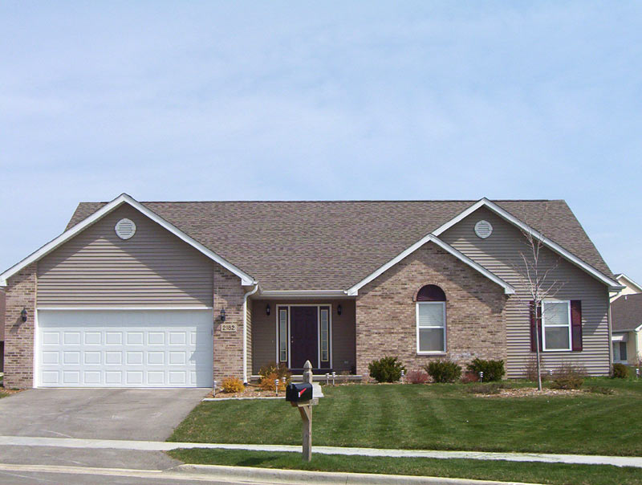
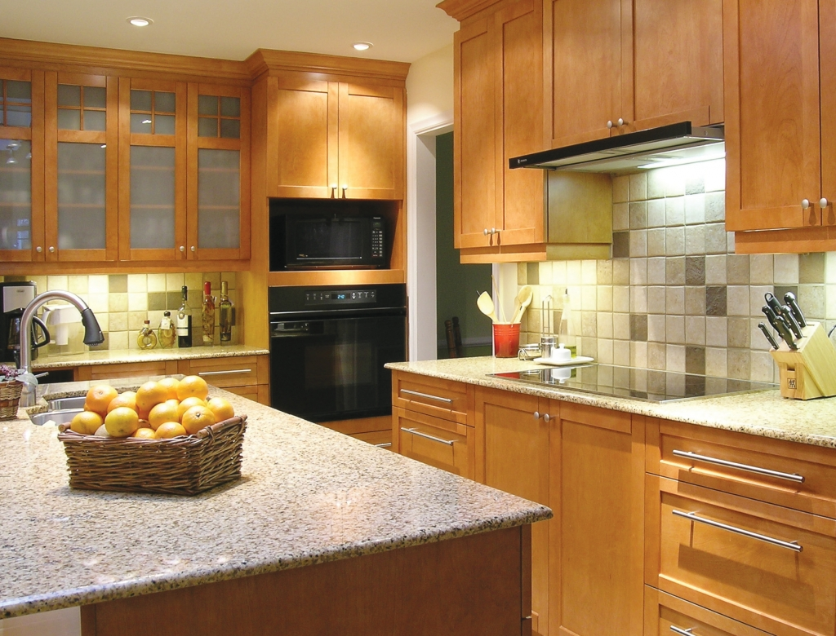

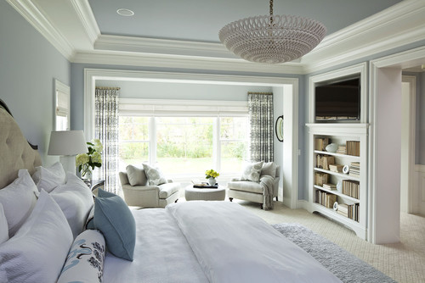
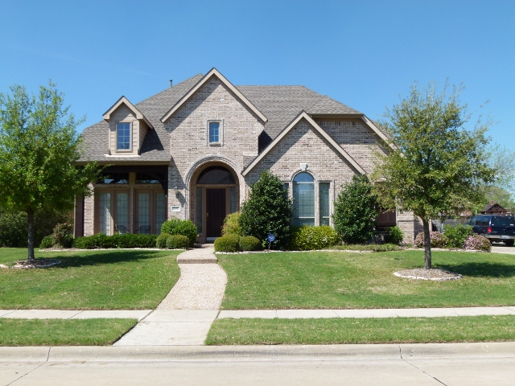
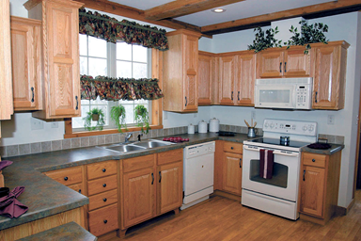
Bedroom
Kitchen

Slide 4
Train
Images
Feature Extraction
InceptionV3
Image net Weights
Test
Images
Bottleneck Layer
Logistic
Regression
Support
Vector Machine
Random Forest
XGBoost
Optimized
Logistic
Optimized
SVM
Optimized
Random Forest
Optimized
XGBoost
Model Evaluation
Accuracy
Precision
Recall
F1
Confusion

Slide 6
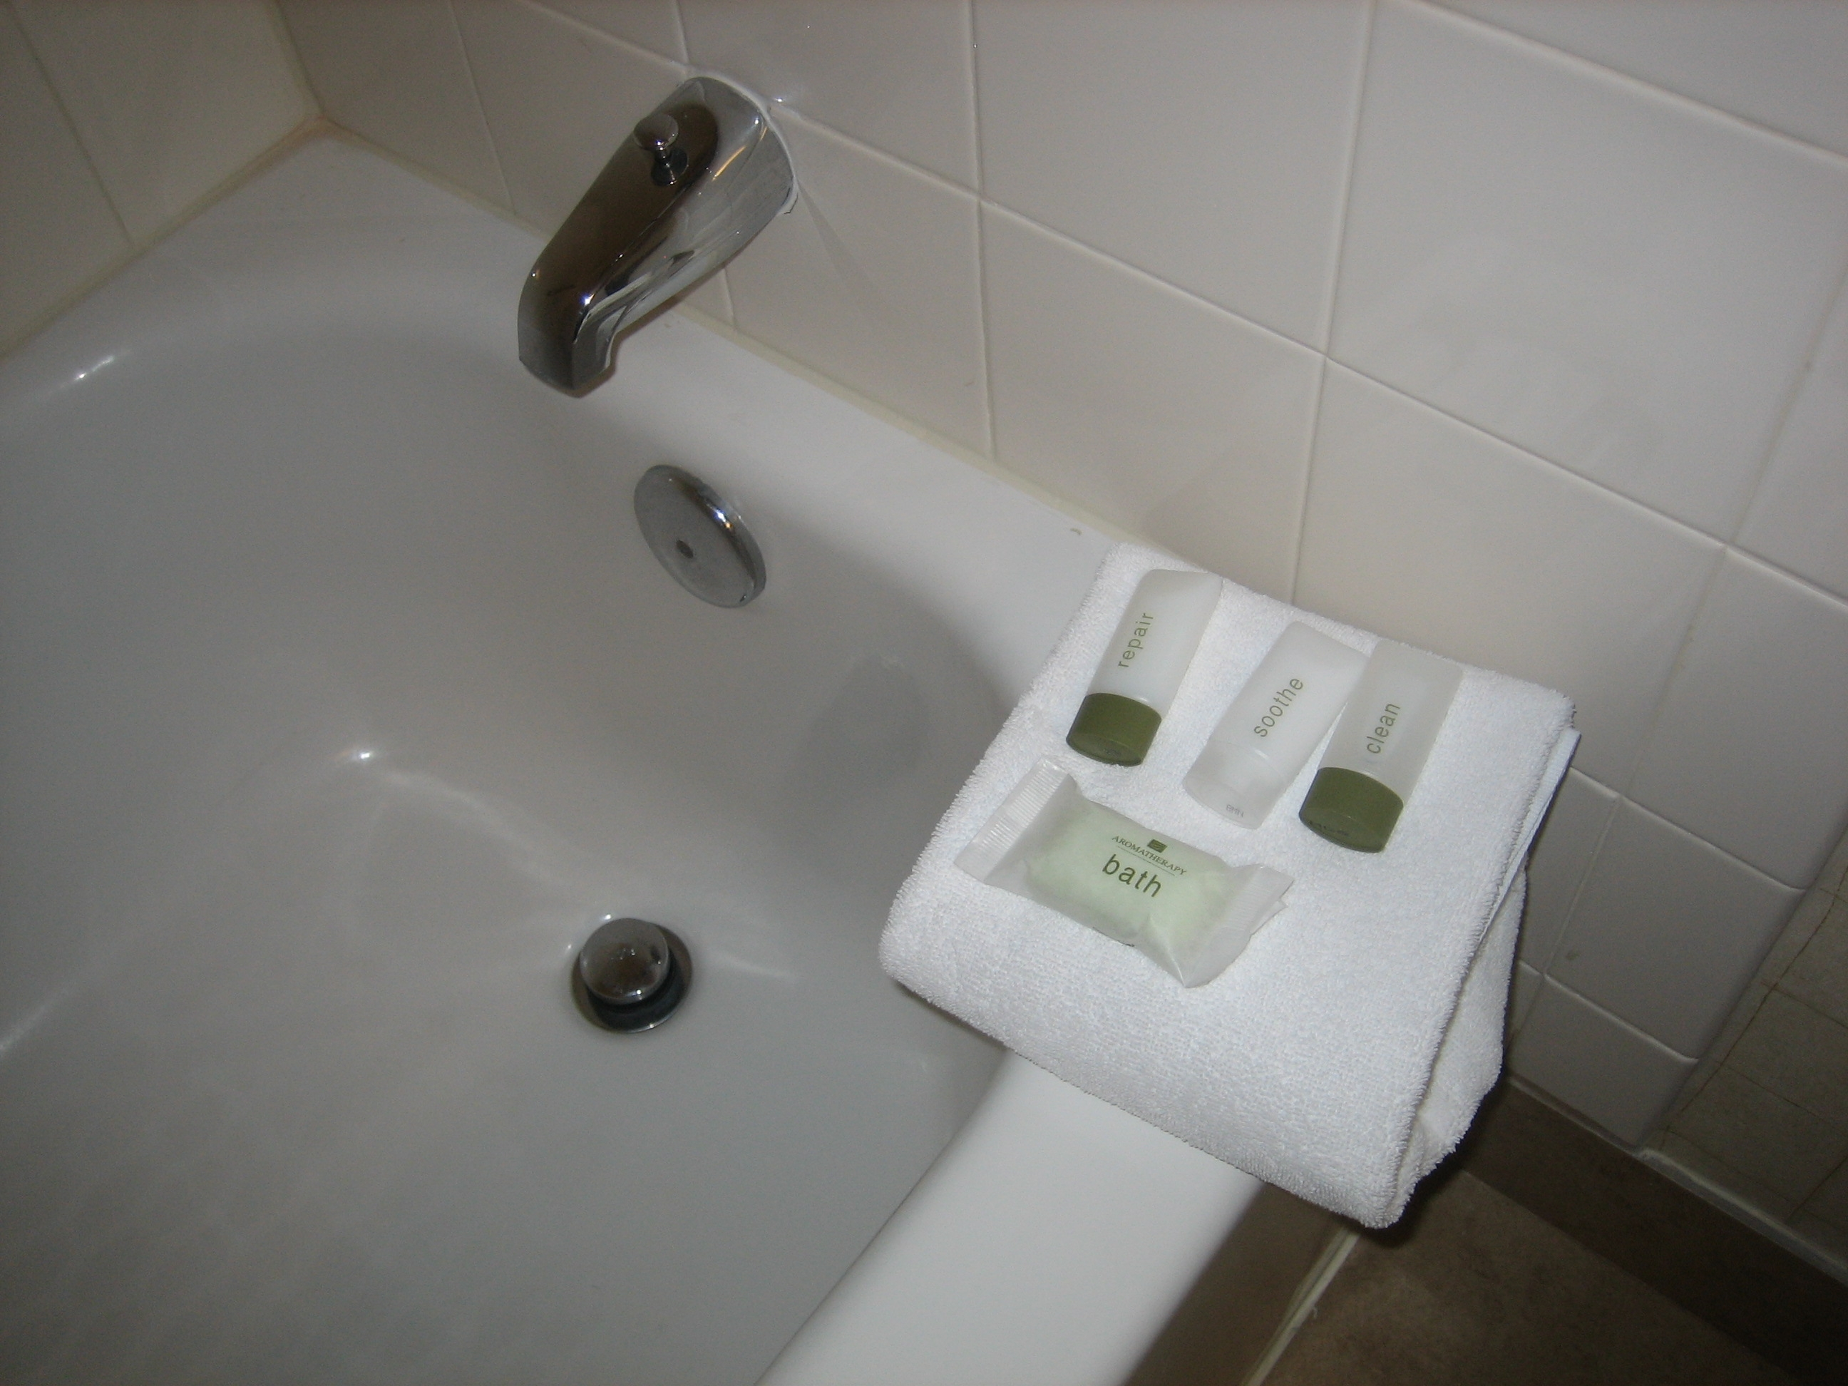
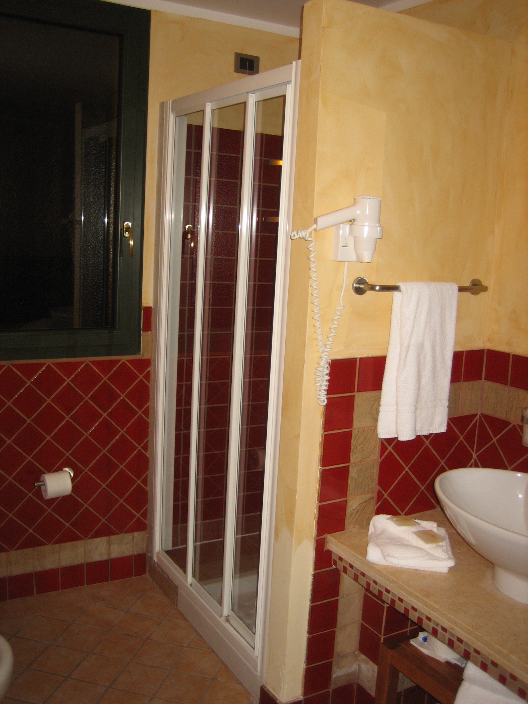
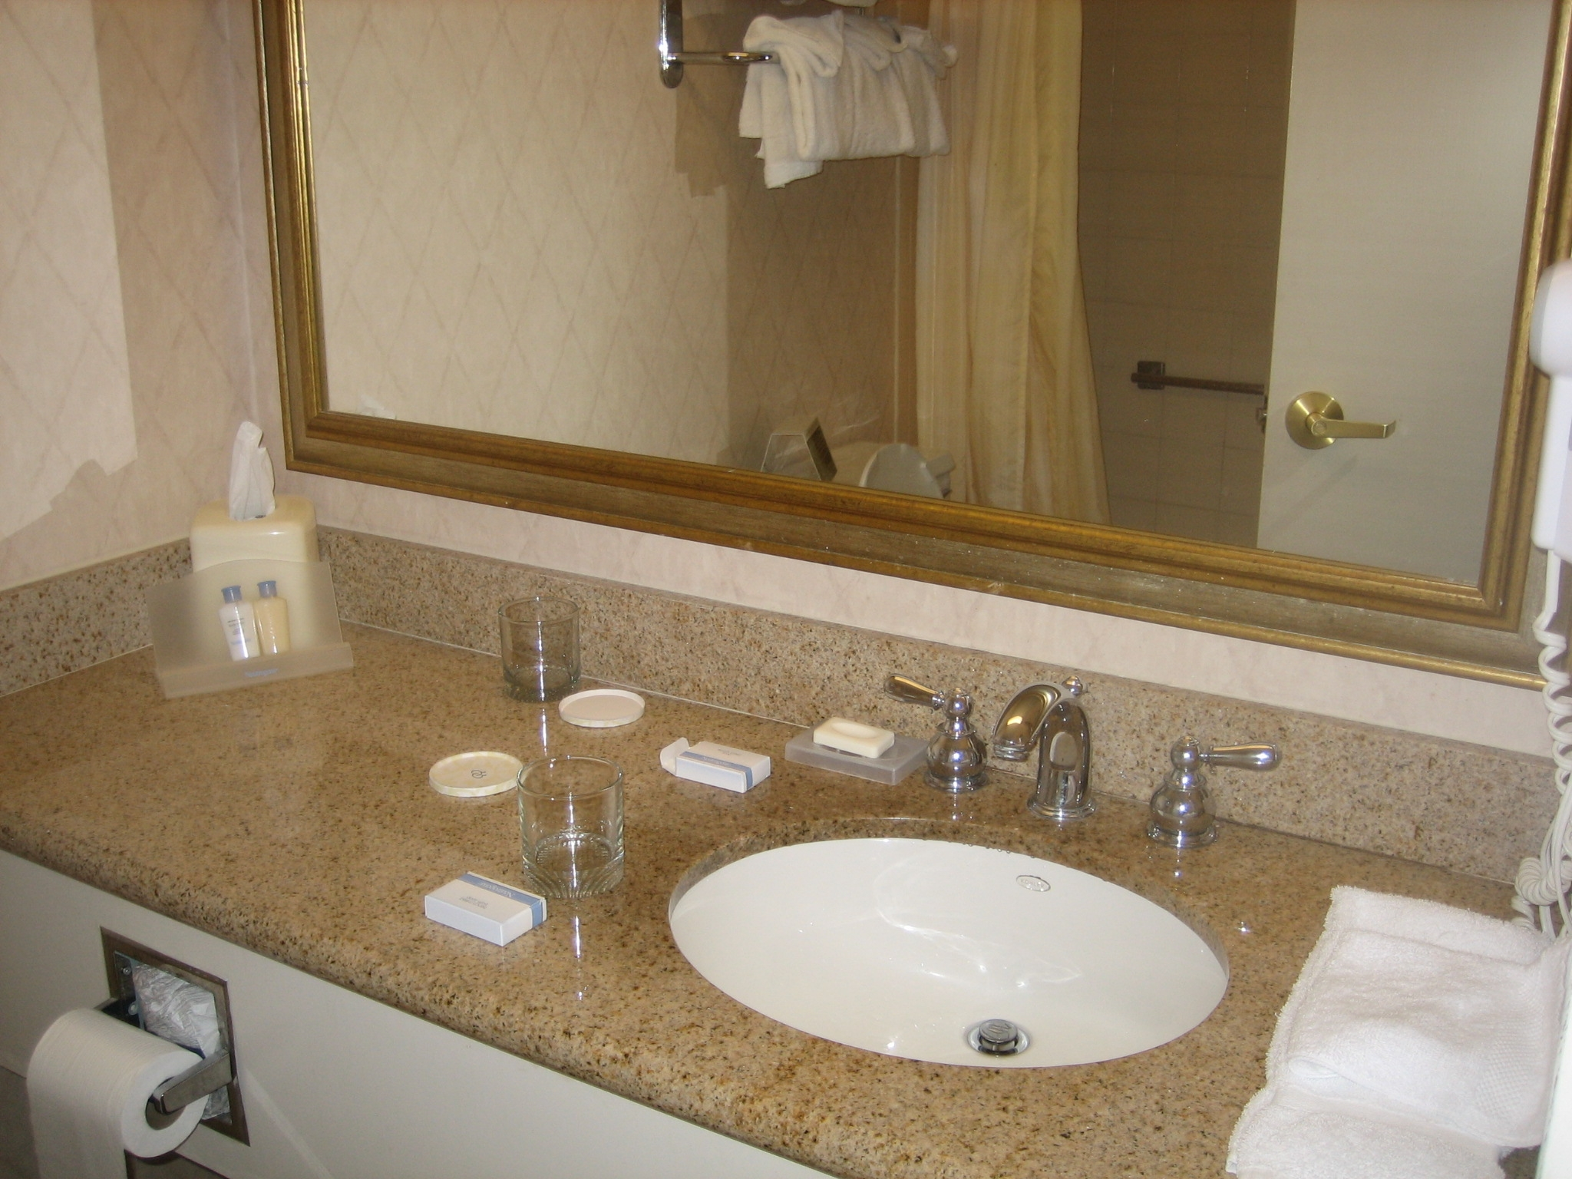
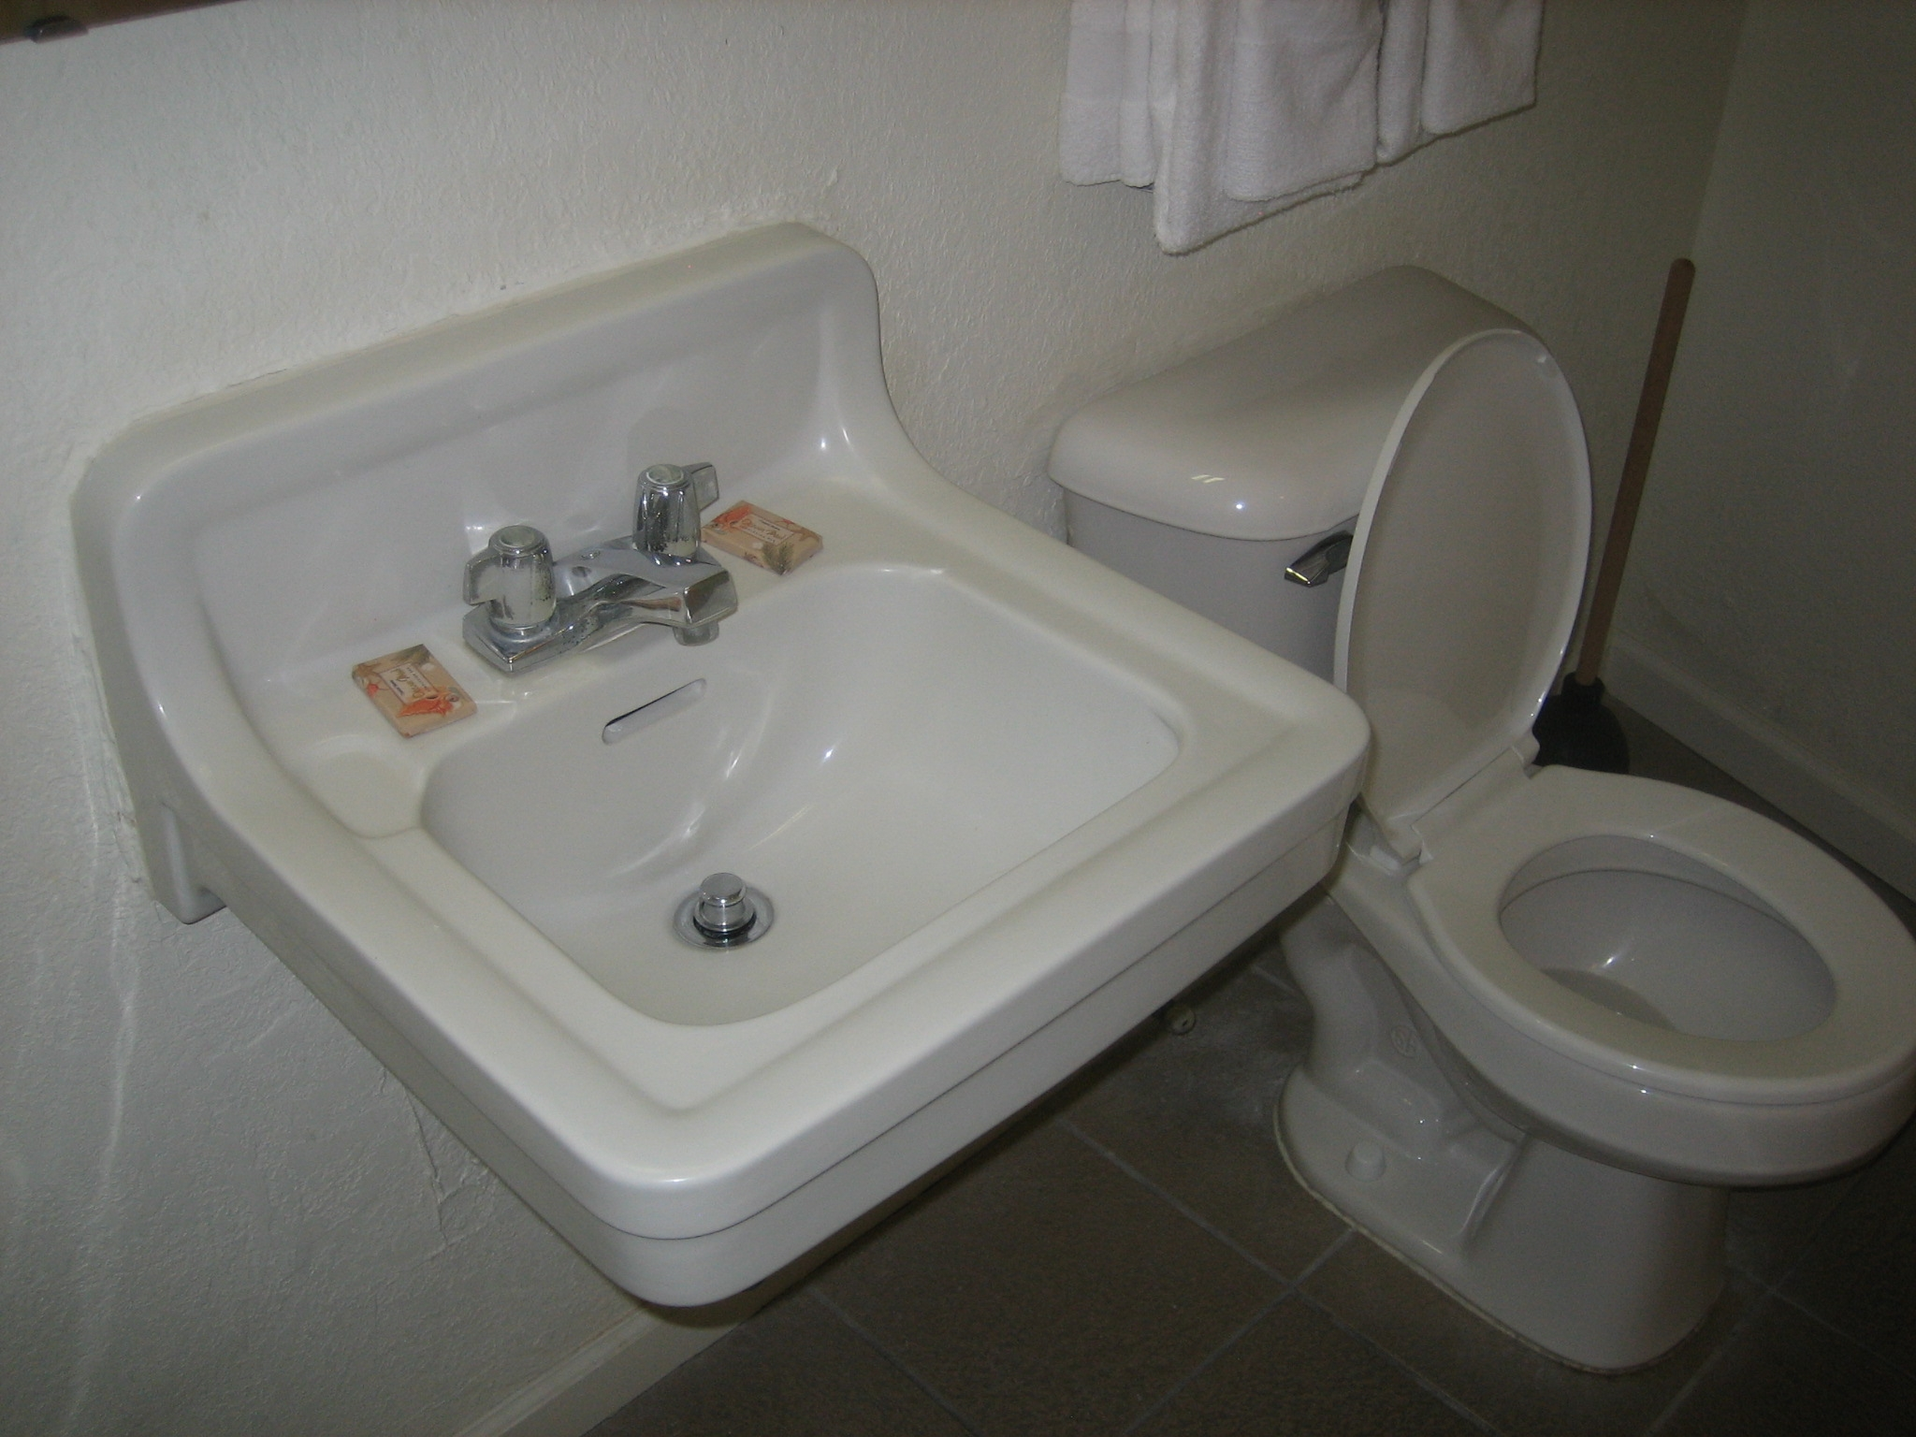
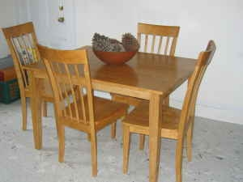
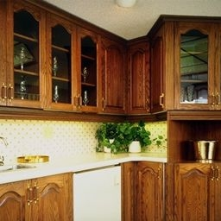
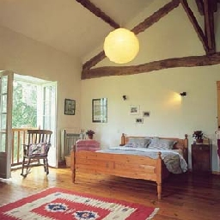
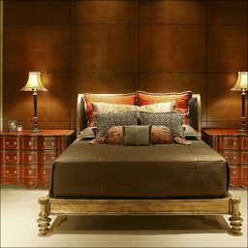
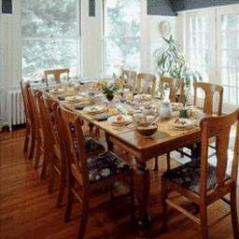
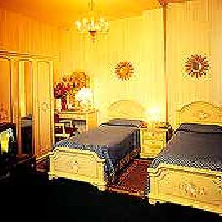
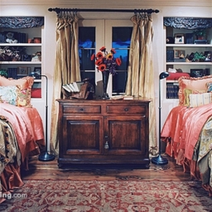
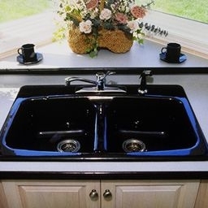
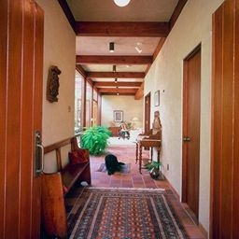
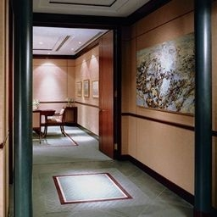
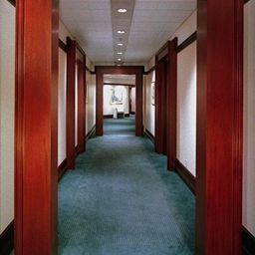
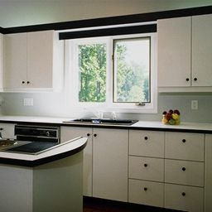
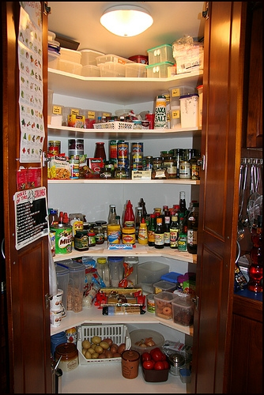
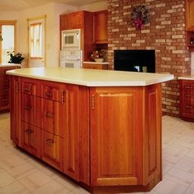
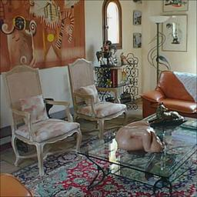
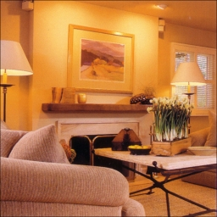
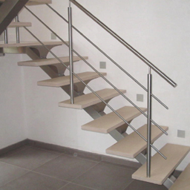
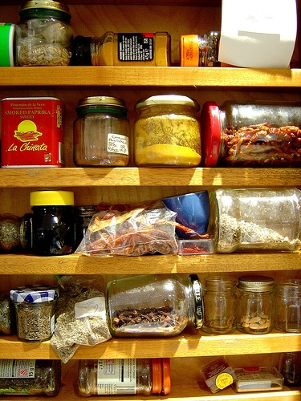

Slide 7
Room | precision_score | recall_score | f1_score | support
bathroom | 0.90 | 0.90 | 0.90 | 20.0
bedroom | 0.83 | 0.75 | 0.79 | 20.0
corridor | 1.00 | 1.00 | 1.00 | 20.0
dining_room | 0.82 | 0.90 | 0.86 | 20.0
kitchen | 0.94 | 0.75 | 0.83 | 20.0
living room | 0.71 | 0.75 | 0.73 | 20.0
pantry | 0.91 | 1.00 | 0.95 | 20.0
staircase | 0.95 | 1.00 | 0.98 | 20.0
avg/total | 0.88 | 0.88 | 0.88 | 160.0

Slide 8
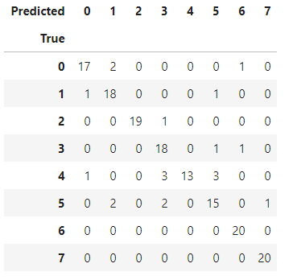

Slide 9
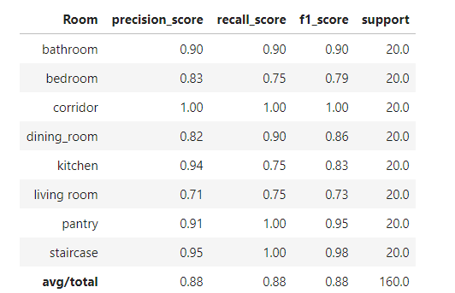
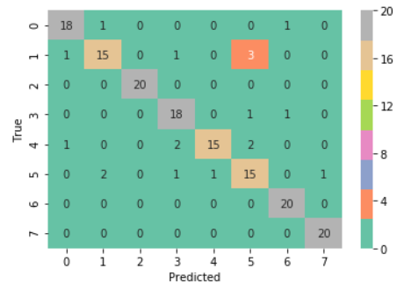
Logistic Regression
Evaluation Metrics Confusion Matrix

Slide 10
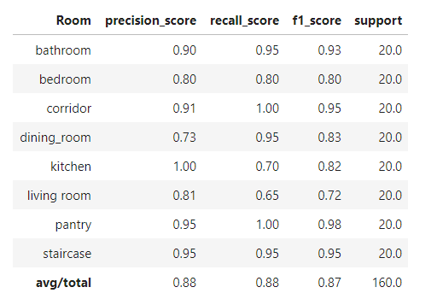
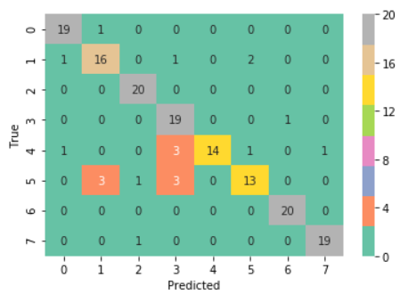
Random Forest
Evaluation Metrics Confusion Matrix

Slide 11
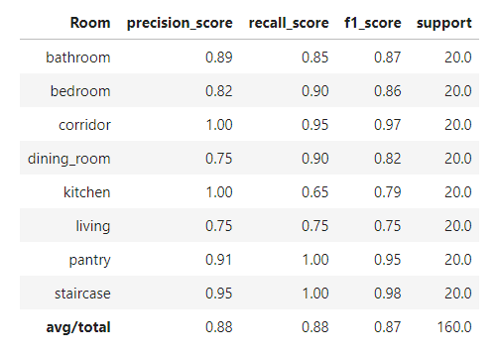
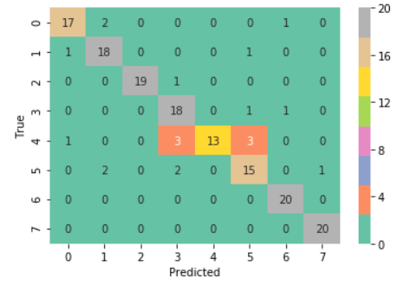
Support Vector
Evaluation Metrics Confusion Matrix

Slide 12
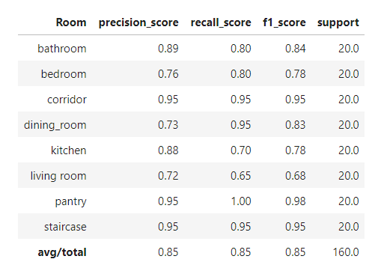
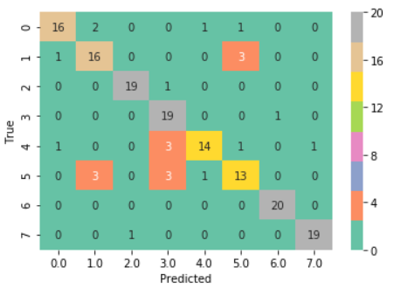
XGBOOST
Evaluation Metrics Confusion Matrix

